Slide 1

SRM INSTITUTE OF SCIENCE AND TECHNOLOGY Ramapuram , Chennai – 600 089 DEPARTMENT OF COMPUTER SCIENCE AND ENGINEERING
21CSC305P/ MACHINE LEARNING
FeelSense : Emotion-driven Conversational AI
BATCH NUMBER : 13
Team Members | Supervisor
 | NAME: Dr. SABITHA. P, AP/CSE
S. P. NIRANJANA | [RA2311003020458]
SHRADDHA. S | [RA2311003020480]
V. PRIYADHARSHINI | [RA2311003020508]

Slide 2
Agenda
Abstract
Scope and Motivation
Introduction
Literature Survey ( Table)
Problem Statement
Objective
Proposed Work
Flow Diagram
Modules and description
Algorithm
Implementation
Results and Discussion-Comparison with Existing Work(Table/Graphs)
Conclusion
Future Work
References

Slide 3
Abstract
This project is about a smart chatbot that can understand people’s emotions.
Users can talk to the bot using text or voice. (voice will be converted to text)
The bot uses AI models to find out if the user is happy, sad, angry, scared, or feeling any another emotion.
After each chat, the bot asks the user if the emotion detected was correct. (feedback)
These feedback answers are saved and studied to check how well the bot is doing.
The bot keeps learning and improving over time using this feedback.
Because it understands emotions and responds kindly, it can be useful for mental health and emotional support.

Slide 4
Scope and Motivation
Scope:
The chatbot can interact with users through text or voice.
It can detect emotions such as happiness, sadness, anger, fear, etc.
It gives empathetic replies based on the user’s feelings.
It includes a feedback system to check if the emotion detected was right.
The system can be used in mental wellness apps, customer support, or virtual assistants.
Motivation:
Many chatbots today don’t understand human emotions.
People often want a chatbot that can respond with care and empathy.
Emotional awareness in AI can help in mental health support and better human–computer communication.
The goal is to make technology more human-like and emotionally intelligent.

Slide 5
Introduction
Talking with feelings is very important for people, but most chatbots cannot understand emotions.
FeelSense is a smart chatbot that can understand both text and voice messages.
It uses a machine learning method called SGD Classifier to find the user’s emotion, like happy, sad, angry, or anxious.
The bot gives kind and suitable replies based on the user’s feelings.
It has a feedback system where the user can say if the emotion detected was right or wrong.
This helps the bot learn and get better over time.
FeelSense can be used for mental health support, helping students before exams, and checking how employees feel at work.

Slide 6
Literature Survey
 | Title of the Paper | Year | Methodology Used | Inferences
1. | AI Chatbot with Emotional Recognition for an Improved Customer Service Experience | 2024 | The paper uses a variable-length context model with speaker-aware units and a top-K normalization layer to select the most relevant parts of a conversation for emotion prediction. | This approach improved emotion recognition accuracy and outperformed fixed context models on three public datasets.
2. | The Acoustically Emotion-Aware Conversational Agent With Speech Emotion Recognition and Empathetic Responses | 2023 | The study made a chatbot that can understand emotions from a person’s voice and reply with kind and caring messages. It was tested with 75 people to see how well it worked. | People felt the chatbot was more understanding and it helped reduce their negative feelings.
3. | Classification of Mental Health and Emotion of Human from Text using Machine Learning Approaches | 2023 | The study built a chatbot that can understand emotions from a person’s voice and give kind, empathetic replies. It was tested with 75 people to check how well it understood and responded to emotions. | People felt that the chatbot was more emotionally intelligent and that it helped reduce their negative feelings during conversations.

Slide 7
Objective
To build an emotion-aware chatbot that can understand how a user feels from their text or speech.
To analyze user input using a trained machine learning model that detects emotions like happy, sad, angry, fear, surprise, or neutral.
To allow users to give feedback if the detected emotion is incorrect, and use that feedback to improve the model automatically.
To store user feedback and correct emotions in a dataset for better future training.
To visualize the model’s performance using accuracy, precision, recall, F1-score, and charts for better understanding.
To create an interactive and user-friendly web interface that makes emotion detection easy to use and understand.

Slide 8
Problem Statement
In normal chatbots, the system only understands the words but not the feelings of the user.
This makes conversations feel robotic and emotionless, reducing user satisfaction.
Humans express emotions through tone, words, and context — but most chatbots cannot detect or respond appropriately to these emotions.
There is a need for a machine learning-based chatbot that can identify emotions from user input and respond accordingly.
By analyzing emotional patterns, the chatbot can improve user interaction, personalize responses, and enhance the overall communication experience.

Slide 9
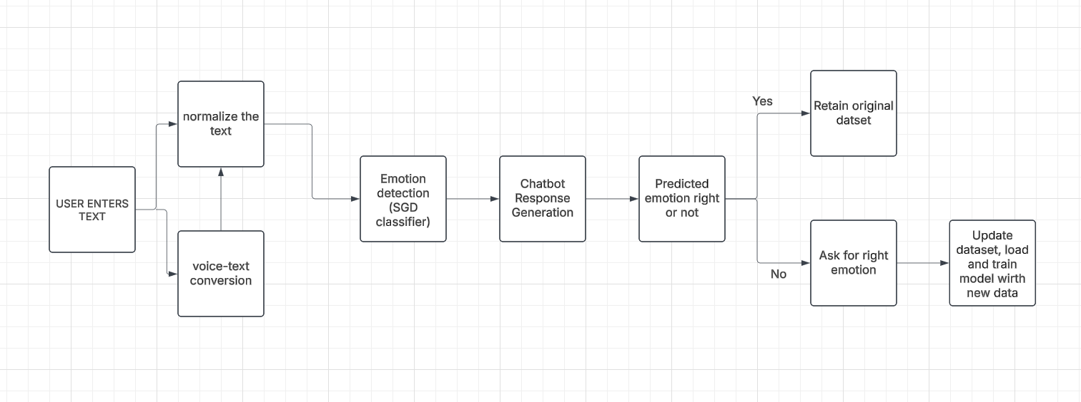
Proposed Work
Flow diagram

Slide 10
Modules and description
Module Name | Description
Data Collection | Gathers data from user interactions and saves it in CSV format for model improvement.
Preprocessing | Cleans and formats input to ensure consistent data for model training and prediction.
Emotion Detection | Applies ML algorithms to classify text/speech into emotion categories.
Chatbot Response | Selects and generates replies that match the detected emotion.
Feedback | Collects user corrections to enhance model performance dynamically.
Metrics Visualization | Computes and displays accuracy, precision, recall, F1-score, and confusion matrix results.
Algorithm :
Input: User text/speech data.
Preprocess: Clean data by removing noise, special characters, and stopwords.
Feature Extraction: Convert text into numerical form (e.g., TF-IDF or Word Embeddings).
Model Training: Train the ML model (e.g., SVM) using the labeled emotion dataset.
Prediction: The model predicts the emotion label for new input.
Response Generation: The chatbot generates emotion-aware responses.
Feedback Update: If the user disagrees, store the correct emotion in the dataset.

Slide 11
Implementation
Component | Details
Back-End Implementation | Language: Python Framework: Flask Libraries: pandas, NumPy, scikit-learn, matplotlib, plotly, flask_sqlalchemy
Dataset Used | Name: emotion.csv Description: Contains text samples labelled with emotions (e.g., joy, sadness, anger, fear, neutral). Additional File: feedback_log.csv (stores user corrections for retraining).
Front-End Implementation | Technologies: HTML, CSS (Tailwind), JavaScript Flask Routes: / → Chat Interface /visualize → Visualization Dashboard /metrics → Model Performance Dashboard
MODEL TRAINING– SGD CLASSIFIER (LOGISTIC REGRESSION AND SVM)
Load and preprocess dataset.
Convert text to numerical features using TF-IDF.
Train model to classify emotions like joy, sadness, anger, fear, neutral.
Save model using joblib for real-time prediction.
INTEGRATION
Flask connects front-end and ML model.
Feedback is stored and retrained periodically to improve emotion detection.

Slide 12
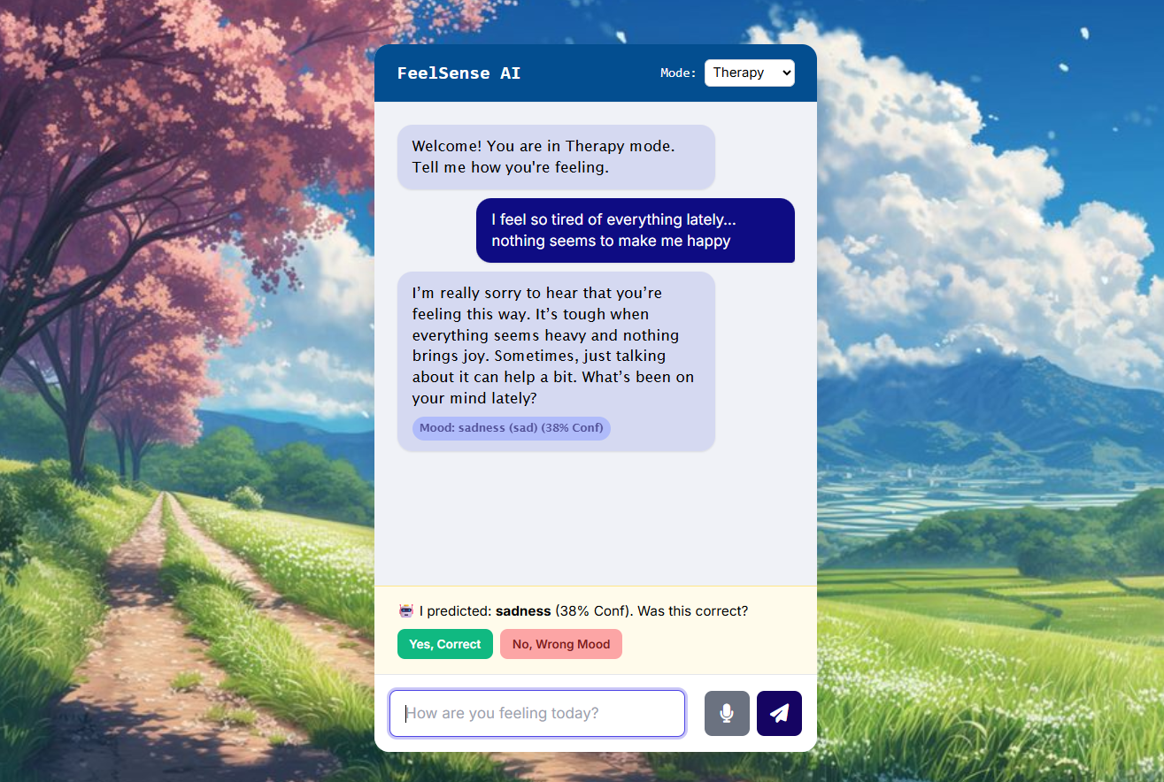
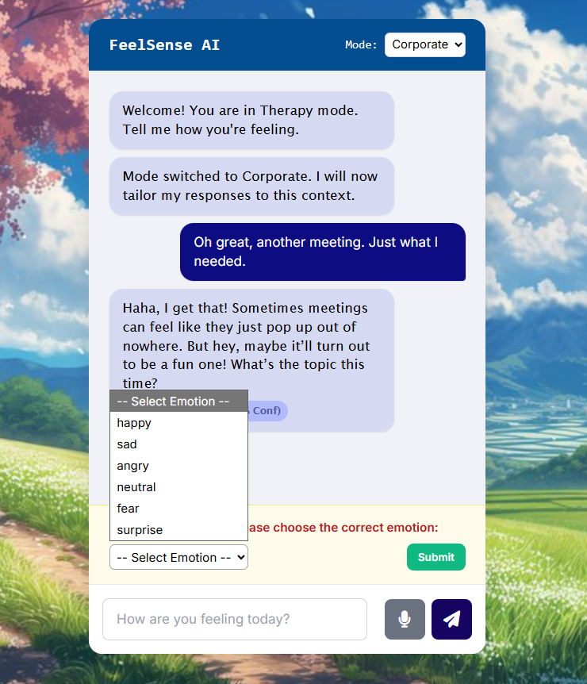
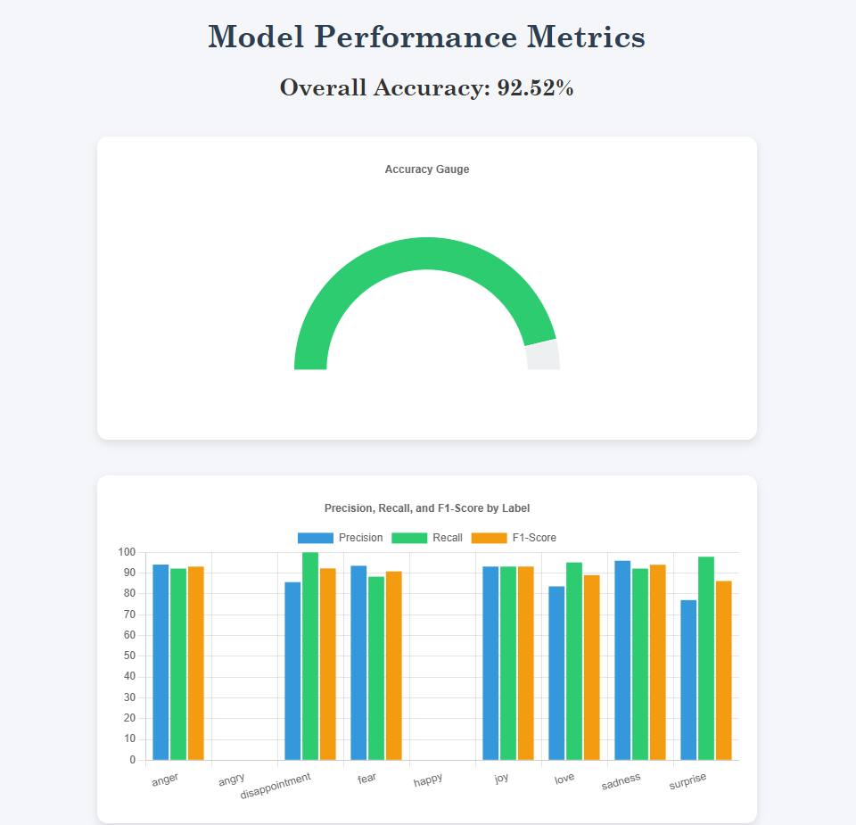
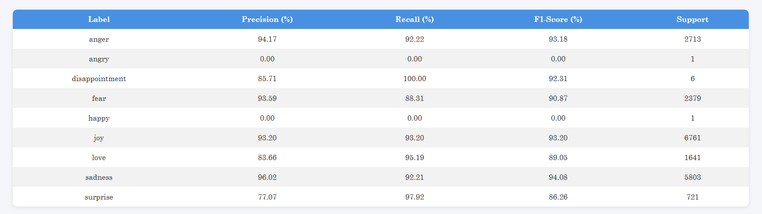
Results and Discussion
Example of model predicting it wrong and user selects the right emotion

Slide 13
Conclusion
The proposed Emotion-Aware Chatbot successfully identifies user emotions from text input using machine learning.
It adapts responses based on detected emotions — enhancing interaction in therapy, education, and corporate settings.
Integrated performance metrics and visual dashboards help monitor model accuracy, precision, and feedback improvement.
The system demonstrates how sentiment and emotion analysis can improve human-computer interaction.
Provides a foundation for personalized and empathetic AI communication.
Continuous feedback logging allows retraining and refinement to improve emotion recognition accuracy over time.

Slide 14
Future Work
Speech Emotion Recognition – Extend the system to detect emotions from tone, pitch, and voice modulation.
Multilingual Support – Enable emotion detection and responses in multiple languages.
Deep Learning Integration – Use advanced models like LSTM or BERT for better emotion understanding.
Personalized Responses – Adapt replies based on user history, mood trends, and behavioral patterns.
Privacy & Ethics – Strengthen data privacy and ensure responsible emotion data usage.

Slide 15
References
OEmoBERTa: Only Using Emotion for Emotion Recognition in Conversation (2022) | A. Wahrman | 2 Citations
SciSpace AI Research Agent | 150+ Tools, 280 M Papers
AI Chatbot with Emotional Recognition for an Improved Customer Service Experience | IEEE Conference Publication | IEEE Xplore
M. Poria, E. Cambria, D. Hazarika, and N. Majumder, “Emotion Recognition in Conversation: Research Challenges, Datasets, and Recent Advances,” IEEE Access, vol. 7, pp. 100943–100953, 2019.
C. Sravani, P. Kumar, S. Priya, S. K. Yadav, M. J. Rao, and U. D. Prasan, “Constructing a Study Buddy Using MERN Stack Technologies,” EngProc 2024, DOI: 10.3390/engproc2024066027.
(Open Access) Emotion Recognition in Conversation from Variable-Length Context (2023) | Mian Zhang | 2 Citations
SGDClassifier — scikit-learn 1.7.2 documentation
Introduction to Pandas and NumPy | Codecademy
https://chatgpt.com
Welcome to Flask — Flask Documentation (3.1.x)

